Slide 1
Surgical Robots
With FULL AUTONOMY in the next DECADE
Jonas Li
November 1, 2024
Notes:
Today, Im goona talk about surgical robots. I would say in the next decade, surgical robots with full autonomy will replace human in some specific procedures in the operation. You are going to have a robot surgeon, and you should feel safer as a result.

Slide 2
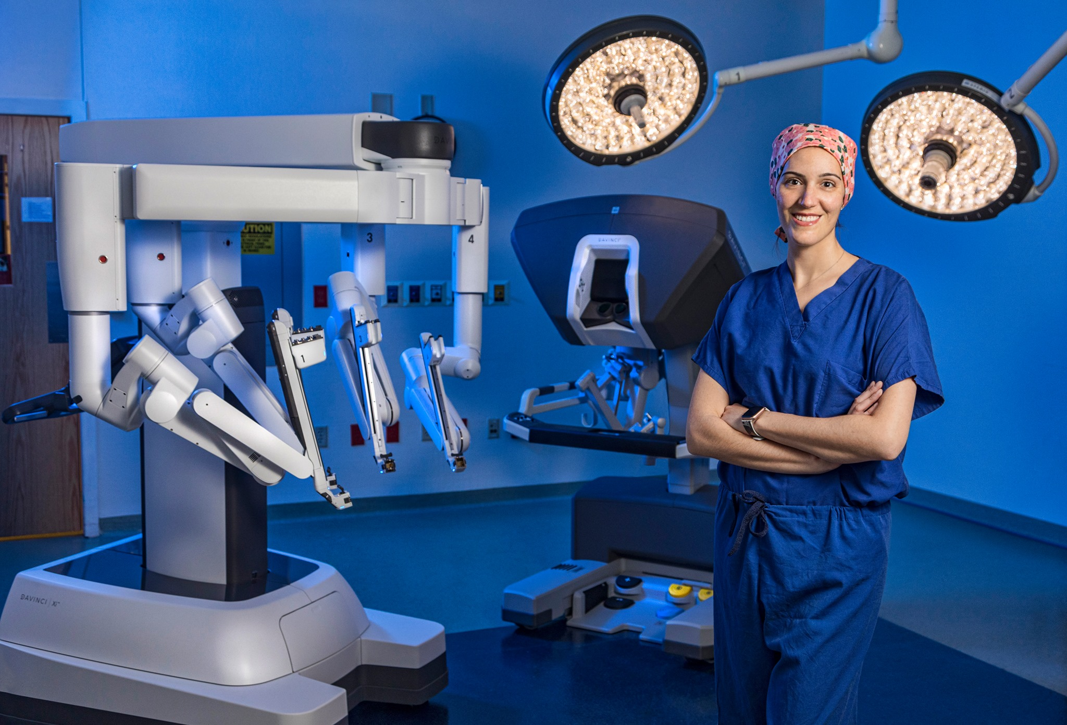
Notes:
In the future, human surgeons with less participation will be assistants for surgical robots during the operation process.

Slide 3

Benefit
LESS Blood Loss
FEWER Complications
SMALLER Incisions
Notes:
Even the most skilled surgeons can experience fatigue, stress, and hand tremor, which can lead to errors during delicate operations.
However, autonomous systems can perform with consistent precision for extended periods, regardless of external factor

Slide 4
Previously …
Notes:
Even the most skilled surgeons can experience fatigue, stress, and hand tremor, which can lead to errors during delicate operations.
However, autonomous systems can perform with consistent precision for extended periods, regardless of external factor

Slide 5
Real-Time Recognition
Decision-Making
Force Feedback
Notes:
Even the most skilled surgeons can experience fatigue, stress, and hand tremor, which can lead to errors during delicate operations.
However, autonomous systems can perform with consistent precision for extended periods, regardless of external factor

Slide 6
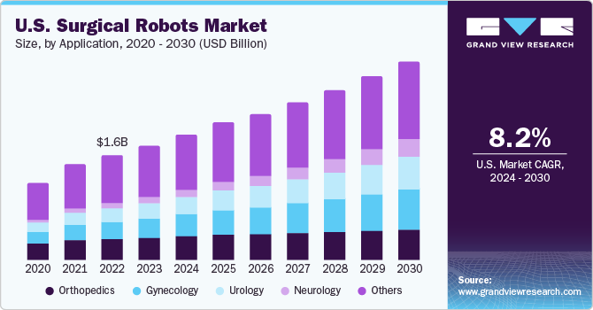








Slide 7
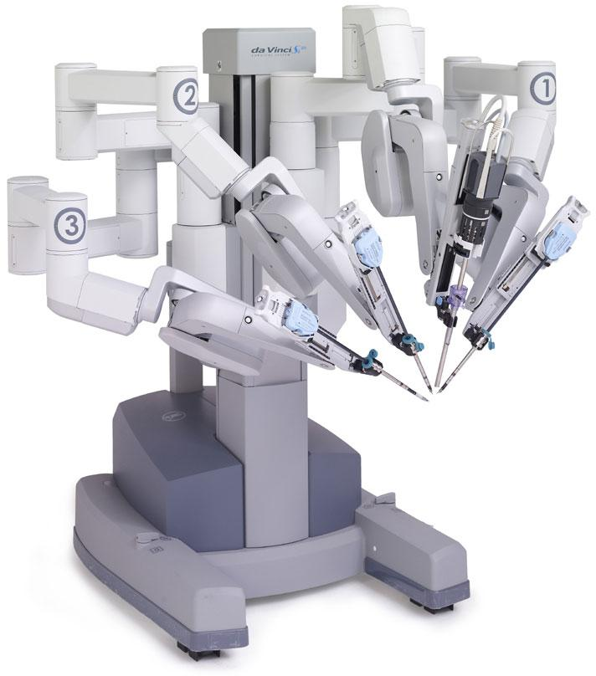
Currently
Computer Vision
Simulation platform
Haptic feedback systems

Slide 8

You Can Expect
Less blood loss
Fewer complications
Smaller incisions
Better experience

Slide 9
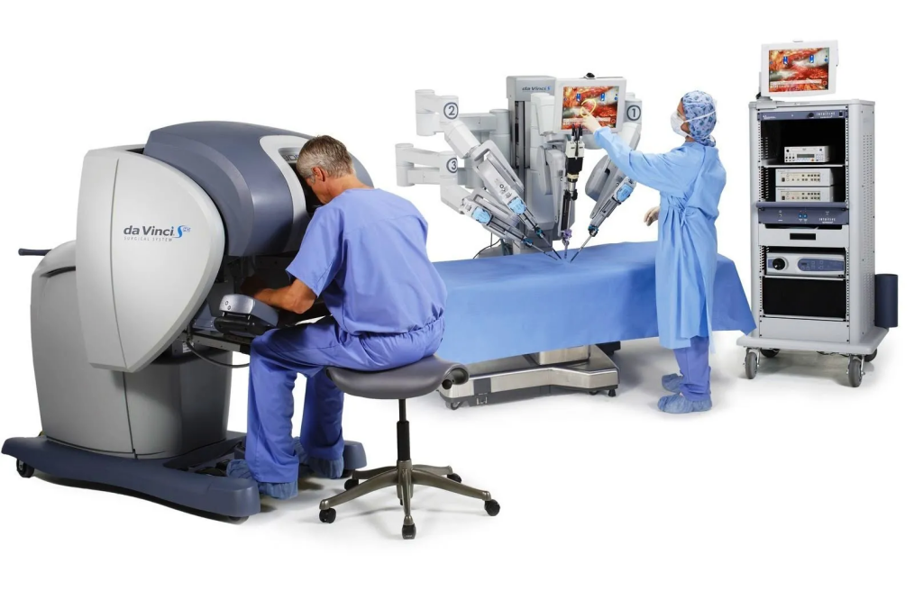
Robotic Arms
Surgeon Console

